Slide 1
Ballebaaj – Alexa Skill
Submitted by
Akhil Nadh Pc
Atri Saxena
Sooraj Manohar

Slide 2
Contents
IDs
Introduction
Language Used
Intents used
Slots Used
Session Variables Used
Utterances
Future Scope
Conclusion

Slide 3
IDS
Skill ID amzn1.ask.skill.5ef5b454-95ff-4090-a4ff-d379b1696267
Vendor ID M2M2KT9WBLYLWH

Slide 4
Introduction
Ballabaaj is a fun game developed for Alexa.
You need to bat and attain a certain target to win the game
You have got 2 overs and 1 wicke
Alexa will play as Team 'Gendabaaj'
Team 'Gendabaaj' has finished batting. Now, You need to chase our score to win.
You need to pick and say a number from 0 to 6
which you think you could possibly take in every bowl. It is called Ballebaaj runs
Similarly, We 'Gendabaaj', the bowling team will also select the bowling number called Gendabaaj bowl.
If both numbers happens to be same . You will loose a wicket
If Both numbers are different, then you will get that much number of runs.

Slide 5
Language Used
Python version 3.6
AWS Lambda as backed server.

Slide 6
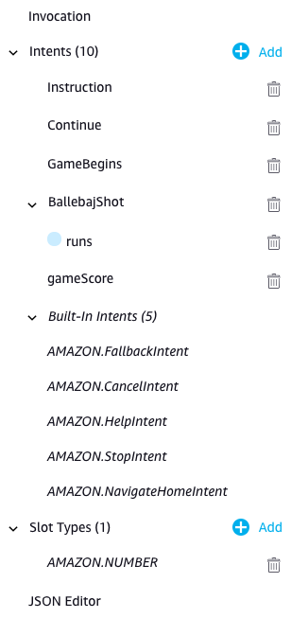
Intents Used
Custom Intents
Instruction
Continue
GameBegins
BallebajShot
gameScore
Built-In Intents
AMAZON.StopIntent
AMAZON.FallbackIntent

Slide 7
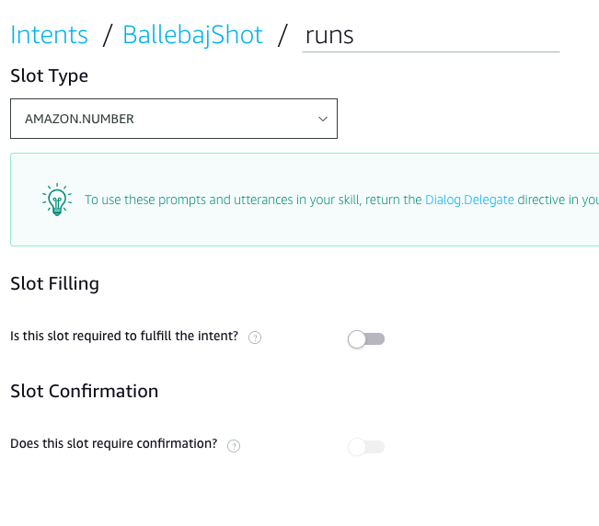
SlotsUsed
Slots Used
runs

Slide 8
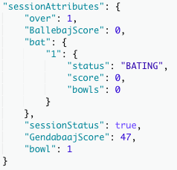
Session Variables Used
Slots Used
Over
BallebajScore
1
Status
Score
Bowls
sessionStatus
GendabaajScore
bowl

Slide 9
Utterances
Invocation Alexa, Open Ballebaaj
Instrution Instruction
Begin the game Start
Score a Run Runs 5
To check the score Score

Slide 10
Future Scope
Features Expected in Next Update
gameplay will be modified to 3 wickets and 6 overs
Special music and sounds if person got Duck , centaury or fifty.

Slide 11
Conclusion
Learned how to develop Alexa Skill
Learned how to use AWS Lambda

Slide 12
Thank You.

